Slide 1


Impactful presentations
made easy
PICKIT BUSINESS ADMIN GUIDE

Slide 2

This is where you log in to your image bank.
You can either log in with your email and password or directly with your O365 account.

Slide 3
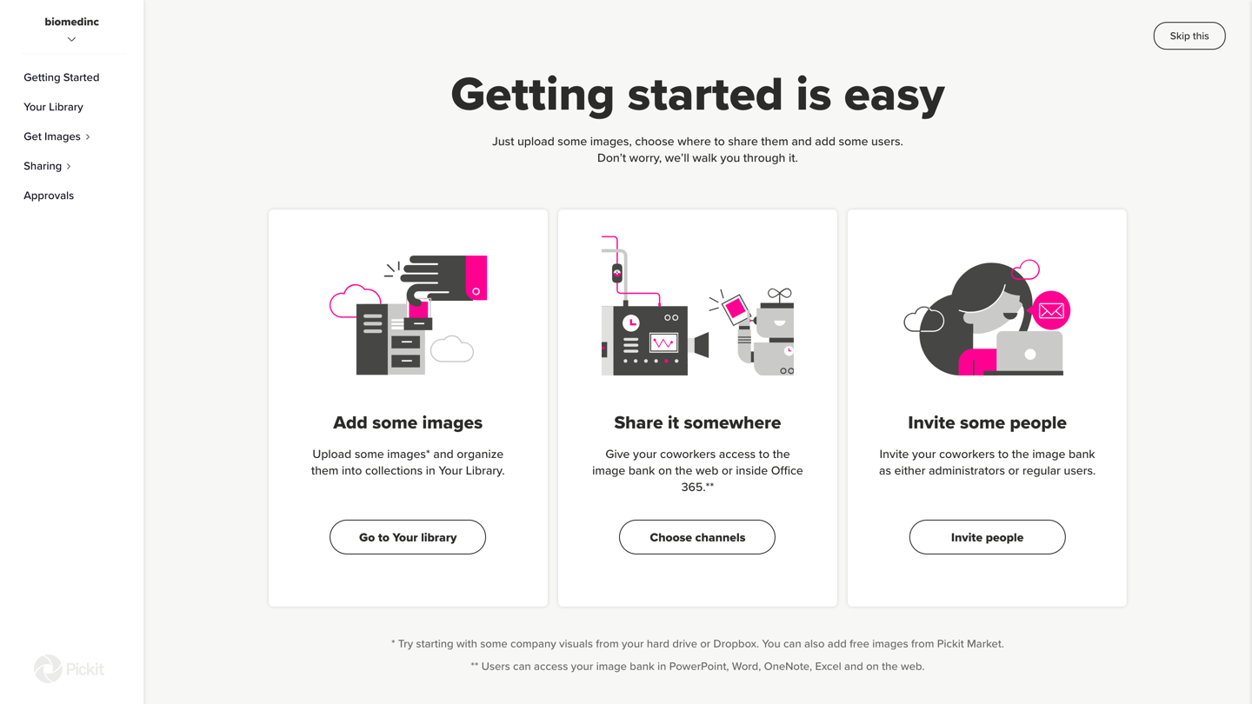
After you’ve logged in, this is the page you’ll see.
These are the steps you should follow to get started with your image service.

Slide 4
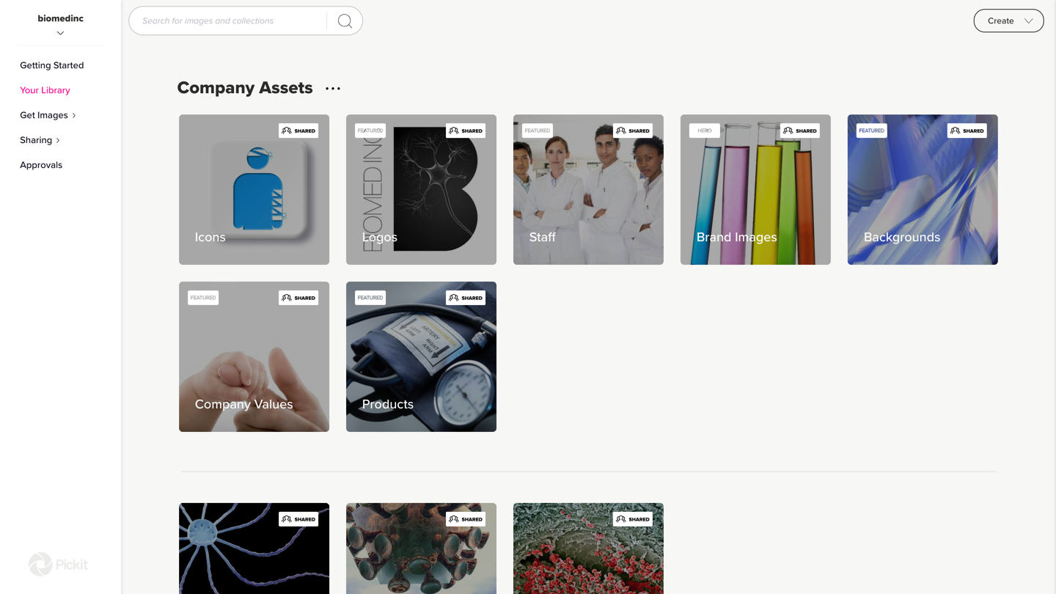
You can create collections and categorize them into collection groups by clicking on “Create”.
You can create collections and categorize them into collection groups by clicking on “Create”.
Your Library is the place where you manage your collections.
To insert a collection into a collection group, just drag and drop it into the group.

Slide 5

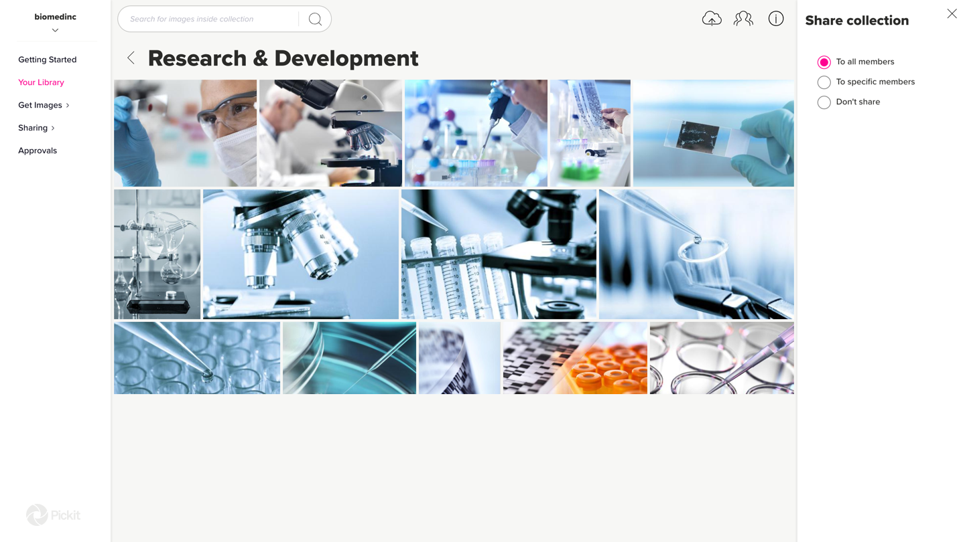
To upload images to your collection, select the cloud symbol on the top right.
To edit your collection, click into the info button.
You can upload your own thumbnail for the collection here.
In addition to changing the collection name and deleting the collection, you can also “Promote” a collection to make it “Hero” or “Featured”.
Hero collections are positioned on the top of your image bank and Featured collections are located right under the Hero collections. We’ll explain more about this on a later slide. You can see more if you click the pink “info” button next to Promote.
You can also upload your own custom backgrounds to the collections.

Slide 6
Under this icon you can set the collection as private or share it with other members of your team. You can chose who to share it with, or to share it to all your users.

Slide 7
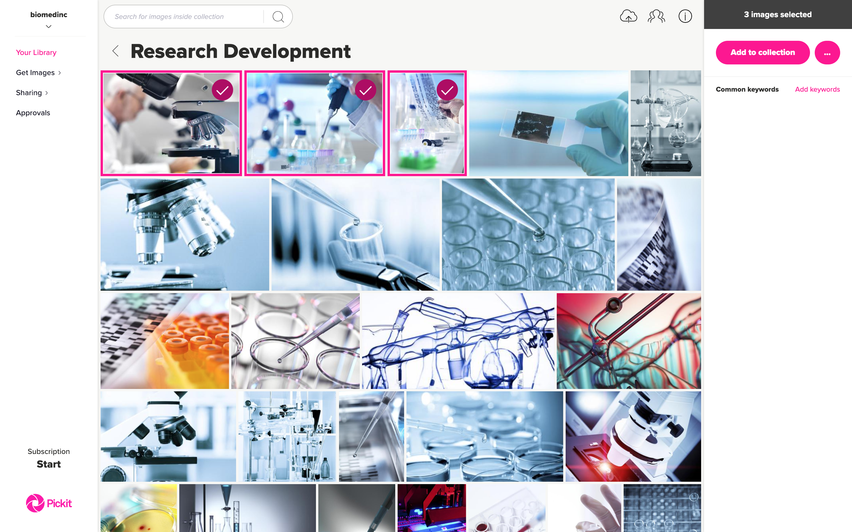
You can multiselect images and add them to other collections. An image can belong to more than one collection.
You can also add and remove common keywords from images.

Slide 8

You can multiselect images and add them to other collections. An image can belong to more than one collection.
You can also add and remove common keywords from images.

Slide 9

Under Get Images> Pickit Market
you get access to Pickit’s complete image library. These images are free for you to use and share with your coworkers.

Slide 10
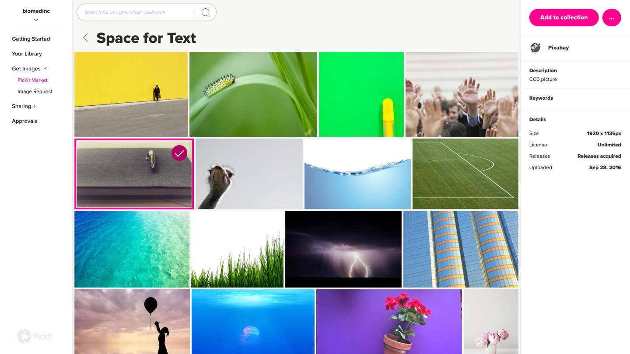
To add images from Pickit into your own collections, just select the desired images, click on Add to collection and choose the collection you would like to add them to.

Slide 11
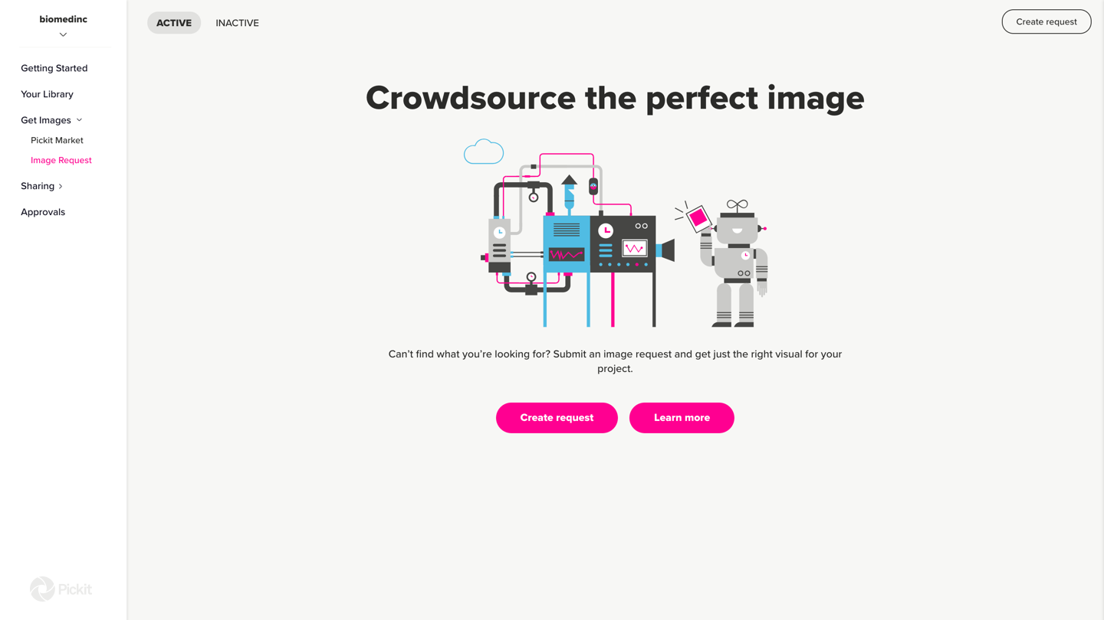
Another way to source images is using the Image Request feature. You can create a private request for internal use at your company, or post a public request to our photographer community. It’s the perfect way to get just the right visual for your project, and you choose the price.

Slide 12
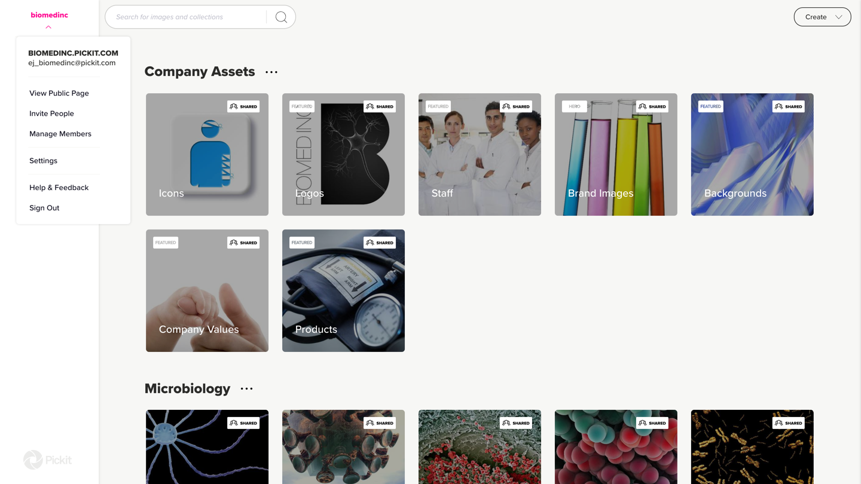
In the top left corner is where all the settings regarding the image bank can be found.

Slide 13
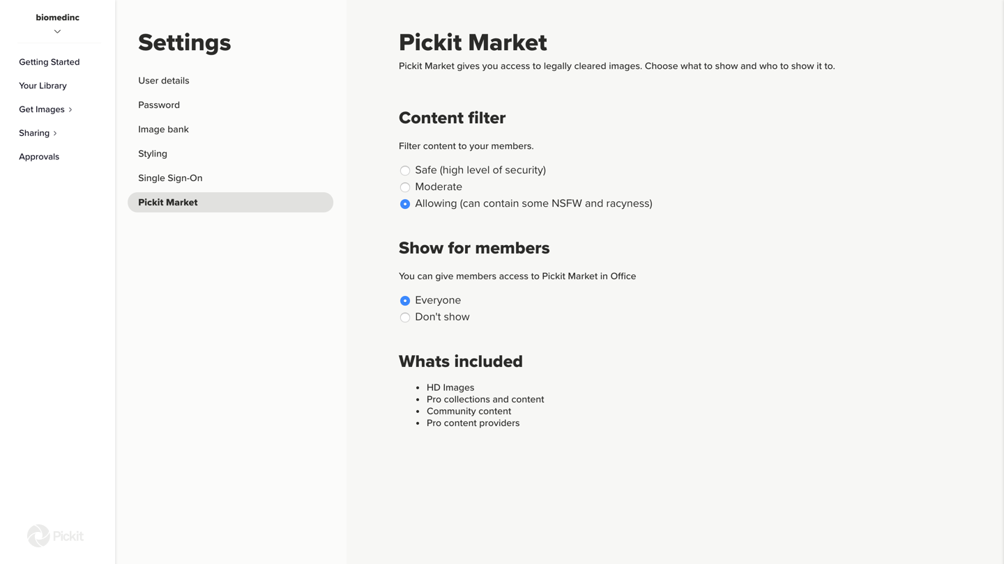
You can set the content filter here and decide what will be shown in Pickit Market.
Safe: No explicit images will be shown.
Moderate: Sensitive content can be shown e.g. people in underwear or swimwear, blood etc.
Allowing: Can contain explicit content and NSFW images.
Here you can decide whether Pickit Market should be accessible for admins only or for all users inside the add-in.

Slide 14
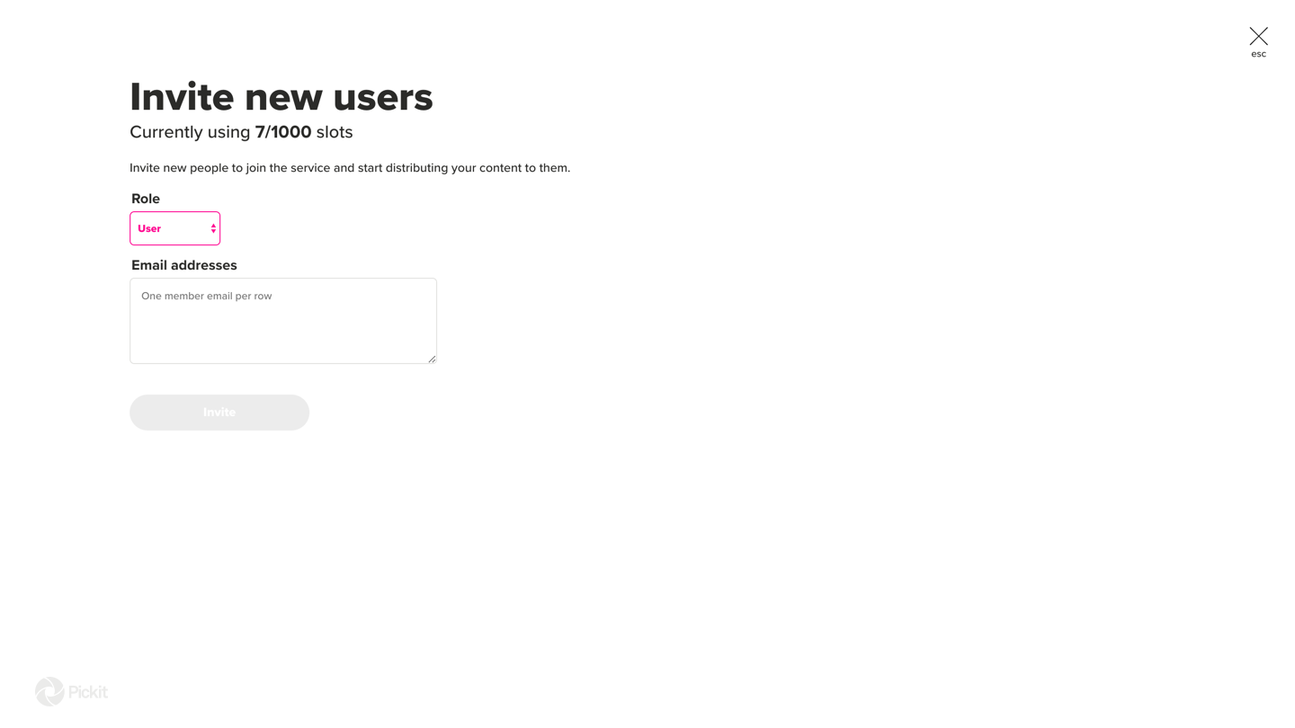
Inviting new users is easy. Just fill in the emails of all the new people you’d like to invite and choose which role they should have.
Users can only search your image database, browse collections they have access to, and download images.
Administrators are the ones that can upload new images, source images from Pickit Market, create Image Requests, and add metadata to images.
Users can also use their company email to access the image bank, in which case they will be automatically assigned the role ”User”.

Slide 15
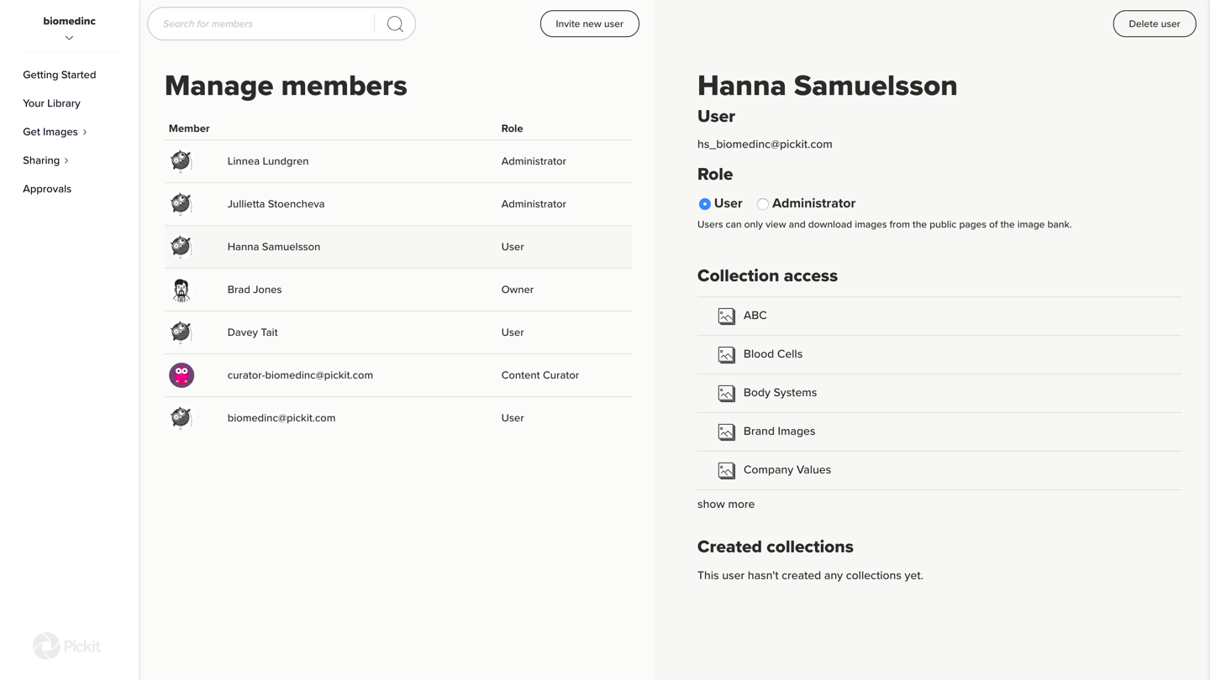
You can change user roles, delete users, or manage their collection access under the Manage members option in the Settings menu.

Slide 16
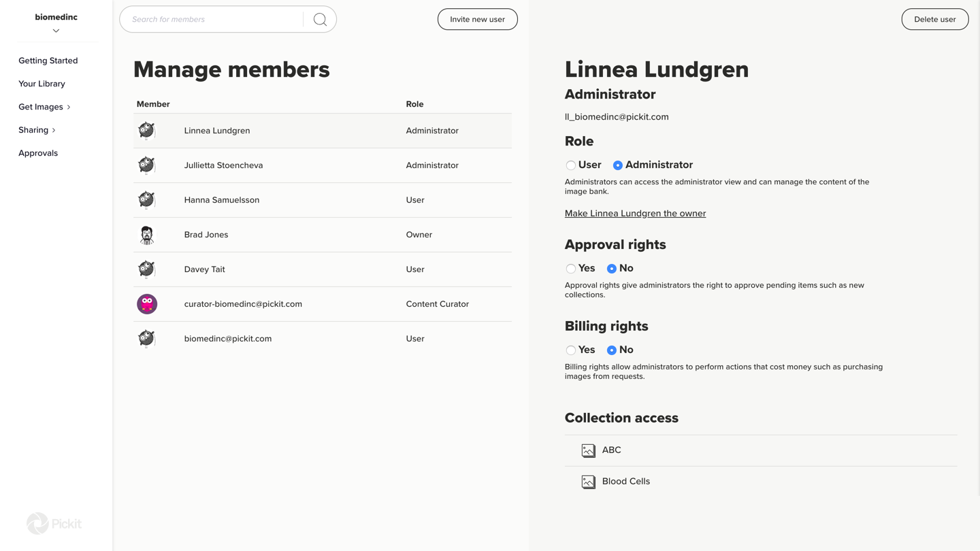
For each administrator, you can assign approval rights and billing rights.
Administrators without approval rights can still upload and source images, but their actions need to be approved by an Administrator with approval rights. Changes pending approval can be found under the Approvals section.
Administrators with billing rights can perform actions that require additional purchases, such as buying an image from a paid Image Request.

Slide 17
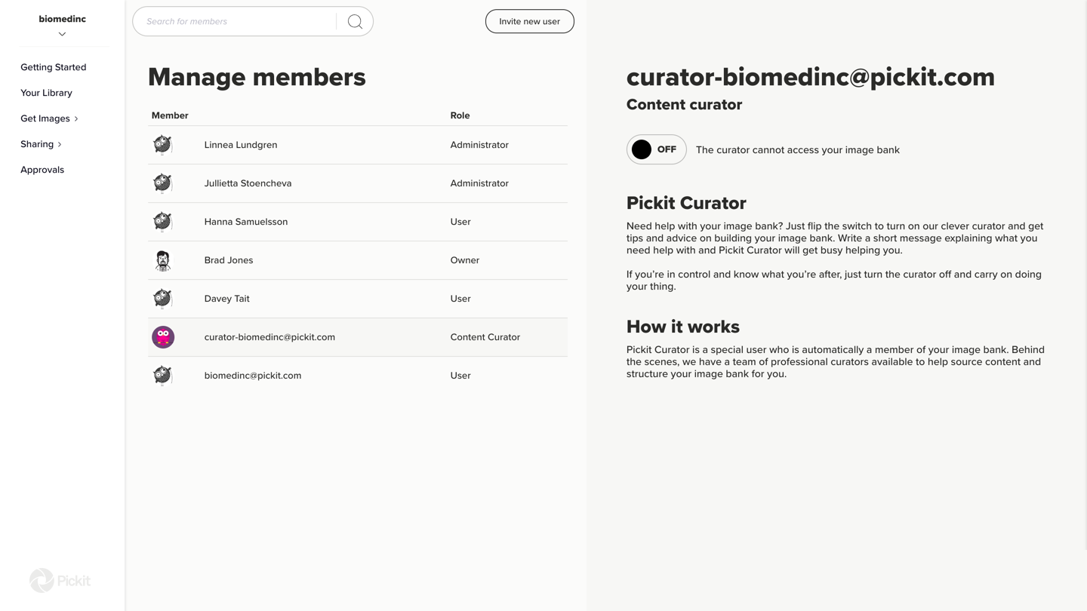
You will see an automatically generated Pickit user in your members list. Switch the toggle to turn on the access for this user if you’d like our image curators to be able to access your image library and help you with your content.

Slide 18
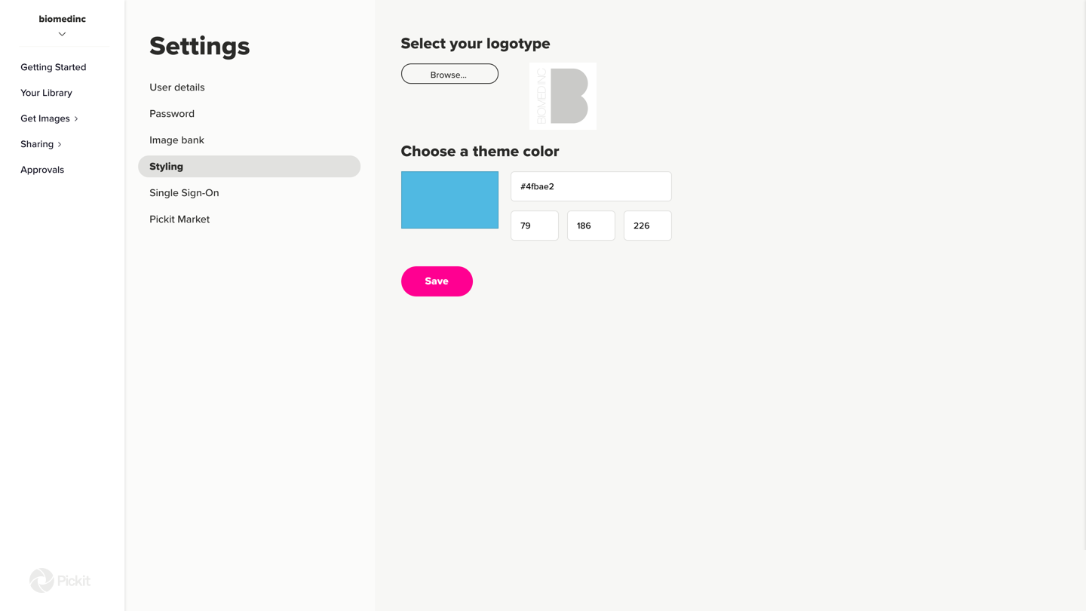
Under Settings > Styling you can choose the theme color and add a logo to your image service to match it with your brand.

Slide 19

By clicking on View Public Page in the menu, you’ll see how your image service looks for all your users.
Here, you can also see how the hero collection and the featured collections look. The hero and featured collections are there as your storefront and where people can access the images easily.

Slide 20
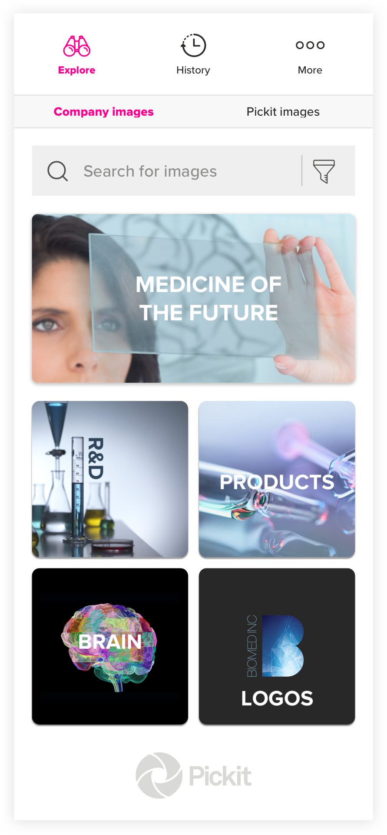
Inside the Office add-in the image bank will look the same with the hero collections on top, the featured collections underneath and your group collections below that.
You can have more than one hero collection. If you have two or more hero collections, they’ll show as a carousel that changes collection every 5 seconds.
By double- clicking on an image you can insert it directly to your presentation.
If you click on the image once, you will open up ”photo details”, where you can read more about the image and insert it.
Next to the Insert button you will see a button with three dots, where you can choose which size the image should have before inserting it.

Slide 21

Impactful presentations
made easy

